Slide 1



University Institute of Engineering
DEPARTMENT OF COMPUTER SCIENCE & ENGINEERING
Subject Name: Software Engineering
Subject Code: 23CST-206
Software Testing
DISCOVER . LEARN . EMPOWER

Slide 2
Chapter-7 Software Testing
Black Box Testing and White Box Testing

Slide 3
Black Box Testing
Black Box Testing is a software testing method in which the functionalities of software applications are tested without having knowledge of internal code structure, implementation details and internal paths.
Black Box Testing mainly focuses on input and output of software applications and it is entirely based on software requirements and specifications.
It is also known as Behavioral Testing.

Slide 4
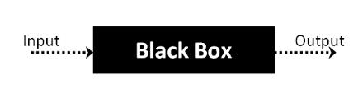
Black Box Testing
The above Black-Box can be any software system you want to test.
For Example, an operating system like Windows, a website like Google, a database like Oracle or even your own custom application.
Under Black Box Testing, you can test these applications by just focusing on the inputs and outputs without knowing their internal code implementation.

Slide 5
Types of Black Box Testing
There are many types of Black Box Testing but the following are the prominent ones -
Functional testing - This black box testing type is related to the functional requirements of a system; it is done by software testers.
Non-functional testing - This type of black box testing is not related to testing of specific functionality, but non-functional requirements such as performance, scalability, usability.
Regression testing - Regression Testing is done after code fixes, upgrades or any other system maintenance to check the new code has not affected the existing code.

Slide 6
Techniques of Black Box Testing:
1. Syntax-Driven Testing
This type of testing is applied to systems that can be syntactically represented by some language.
For example, language can be represented by context-free grammar.
In this, the test cases are generated so that each grammar rule is used at least once.

Slide 7
Techniques of Black Box Testing:
2. Equivalence partitioning
It is often seen that many types of inputs work similarly so instead of giving all of them separately we can group them and test only one input of each group.
The idea is to partition the input domain of the system into several equivalence classes such that each member of the class works similarly.
If a test case in one class results in some error, other members of the class would also result in the same error.

Slide 8
Techniques of Black Box Testing:
3. Boundary value analysis
Boundaries are very good places for errors to occur.
Hence, if test cases are designed for boundary values of the input domain then the efficiency of testing improves and the probability of finding errors also increases.
For example – If the valid range is 10 to 100 then test for 10,100 also apart from valid and invalid inputs.

Slide 9
Techniques of Black Box Testing:
4. Cause effect graphing
This technique establishes a relationship between logical input called causes with corresponding actions called the effect. The causes and effects are represented using Boolean graphs. The following steps are followed:
Identify inputs (causes) and outputs (effect).
Develop a cause-effect graph.
Transform the graph into a decision table.
Convert decision table rules to test cases.

Slide 10
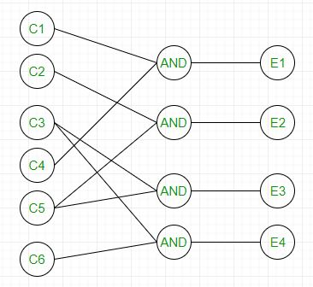
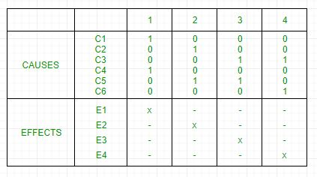
For example, in the following cause-effect graph:
It can be converted into a decision table like:
Each column corresponds to a rule which will become a test case for testing. So there will be 4 test cases.

Slide 11
Techniques of Black Box Testing:
5. Requirement-based testing
It includes validating the requirements given in the SRS of a software system.

Slide 12
Techniques of Black Box Testing:
6. Compatibility testing
The test case results not only depends on the product but is also on the infrastructure for delivering functionality. When the infrastructure parameters are changed it is still expected to work properly. Some parameters that generally affect the compatibility of software are:
Processor (Pentium 3, Pentium 4) and several processors.
Architecture and characteristics of machine (32-bit or 64-bit).
Back-end components such as database servers.
Operating System (Windows, Linux, etc.)

Slide 13
Advantages
Tests are done from a user’s point of view and will help in exposing discrepancies in the specifications.
Tester need not know programming languages or how the software has been implemented.
Tests can be conducted by a body independent from the developers, allowing for an objective perspective and the avoidance of developer-bias.
Test cases can be designed as soon as the specifications are complete.

Slide 14
Disadvantages
Only a small number of possible inputs can be tested and many program paths will be left untested.
Without clear specifications, which is the situation in many projects, test cases will be difficult to design.
Tests can be redundant if the software designer/developer has already run a test case.

Slide 15
White Box Testing
White Box Testing is software testing technique in which internal structure, design and coding of software are tested to verify flow of input-output and to improve design, usability and security.
In white box testing, code is visible to testers so it is also called Clear box testing, Open box testing, Transparent box testing, Code-based testing and Glass box testing.

Slide 16
White Box Testing
White-box testing, sometimes called glass-box testing, is a test-case design philosophy that uses the control structure described as part of component-level design to derive test cases.
Using white-box testing methods, you can derive test cases that
guarantee that all independent paths within a module have been exercised atleast once,
exercise all logical decisions on their true and false sides,
Execute all loops at their boundaries and within their operational bounds, and
Exercise internal data structures to ensure their validity.

Slide 17
What do you verify in White Box Testing?
White box testing involves the testing of the software code for the following:
Internal security holes
Broken or poorly structured paths in the coding processes
The flow of specific inputs through the code
Expected output
The functionality of conditional loops
Testing of each statement, object, and function on an individual basis

Slide 18
Testing techniques
Statement coverage: In this technique, the aim is to traverse all statement at least once. Hence, each line of code is tested.
In case of a flowchart, every node must be traversed at least once. Since all lines of code are covered, helps in pointing out faulty code.

Slide 19
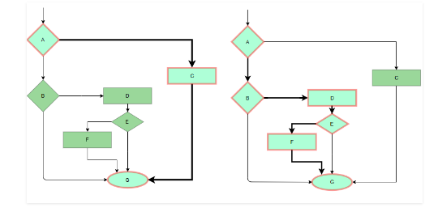
Testing techniques

Slide 20
Testing techniques
Branch Coverage: In this technique, test cases are designed so that each branch from all decision points are traversed at least once.
In a flowchart, all edges must be traversed at least once.

Slide 21
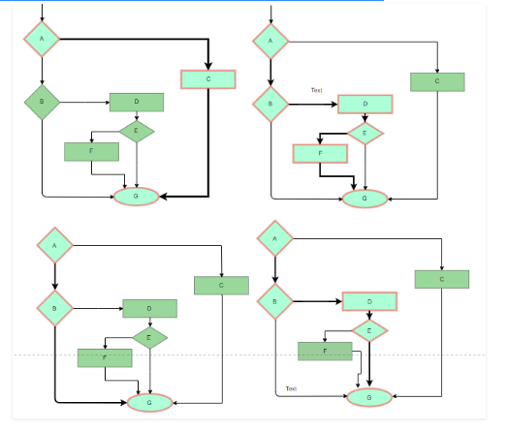

Slide 22
Testing techniques
Condition Coverage: In this technique, all individual conditions must be covered as shown in the following example:
READ X, Y
IF(X == 0 || Y == 0)
PRINT ‘0’
In this example, there are 2 conditions: X == 0 and Y == 0. Now, test these conditions get TRUE and FALSE as their values. One possible example would be:
#TC1 – X = 0, Y = 55
#TC2 – X = 5, Y = 0

Slide 23
Testing techniques
Multiple Condition Coverage: In this technique, all the possible combinations of the possible outcomes of conditions are tested at least once. Let’s consider the following example:
READ X, Y
IF(X == 0 || Y == 0)
PRINT ‘0’
#TC1: X = 0, Y = 0
#TC2: X = 0, Y = 5
#TC3: X = 55, Y = 0
#TC4: X = 55, Y = 5
Hence, four test cases required for two individual conditions. Similarly, if there are n conditions then 2^{n} test cases would be required.

Slide 24
Testing techniques
Basis Path Testing: In this technique, control flow graphs are made from code or flowchart and then Cyclomatic complexity is calculated which defines the number of independent paths so that the minimal number of test cases can be designed for each independent path. Steps :
Make the corresponding control flow graph
Calculate the cyclomatic complexity
Find the independent paths
Design test cases corresponding to each independent path

Slide 25
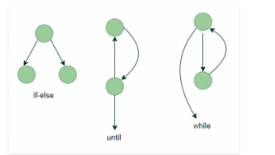
Testing techniques
Flow graph notation: It is a directed graph consisting of nodes and edges. Each node represents a sequence of statements, or a decision point. A predicate node is the one that represents a decision point that contains a condition after which the graph splits. Regions are bounded by nodes and edges.

Slide 26
Testing techniques
Cyclomatic Complexity: It is a measure of the logical complexity of the software and is used to define the number of independent paths. For a graph G, V(G) is its cyclomatic complexity. Calculating V(G):
V(G) = P + 1, where P is the number of predicate nodes in the flow graph
V(G) = E – N + 2, where E is the number of edges and N is the total number of nodes
V(G) = Number of non-overlapping regions in the graph

Slide 27
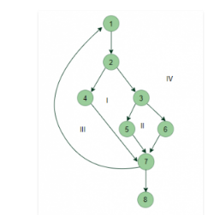

Slide 28
Example
V(G) = 4 (Using any of the above formulae) No of independent paths = 4
#P1: 1 – 2 – 4 – 7 – 8
#P2: 1 – 2 – 3 – 5 – 7 – 8
#P3: 1 – 2 – 3 – 6 – 7 – 8
#P4: 1 – 2 – 4 – 7 – 1 – . . . – 7 – 8

Slide 29
Testing techniques
Loop Testing: Loops are widely used and these are fundamental to many algorithms hence, their testing is very important. Errors often occur at the beginnings and ends of loops.
Simple loops: For simple loops of size n, test cases are designed that:
Skip the loop entirely
Only one pass through the loop
2 passes
m passes, where m < n
n-1 ans n+1 passes

Slide 30
Testing techniques
Nested loops: For nested loops, all the loops are set to their minimum count and we start from the innermost loop. Simple loop tests are conducted for the innermost loop and this is worked outwards till all the loops have been tested.
Concatenated loops: Independent loops, one after another. Simple loop tests are applied for each. If they’re not independent, treat them like nesting.

Slide 31
Advantages:
White box testing is very thorough as the entire code and structures are tested.
It results in the optimization of code removing error and helps in removing extra lines of code.
It can start at an earlier stage as it doesn’t require any interface as in case of black box testing.
Easy to automate.

Slide 32
Disadvantages:
Main disadvantage is that it is very expensive.
Redesign of code and rewriting code needs test cases to be written again.
Testers are required to have in-depth knowledge of the code and programming language as opposed to black box testing.
Missing functionalities cannot be detected as the code that exists is tested.
Very complex and at times not realistic.

Slide 33
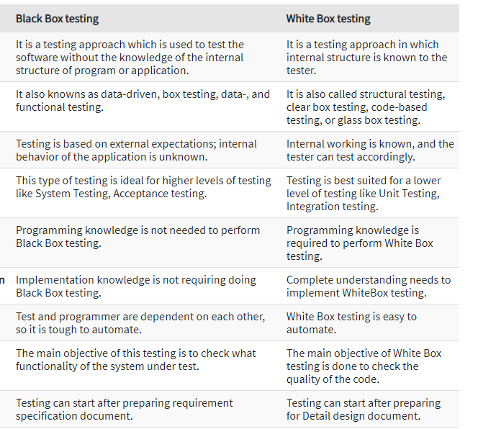

Slide 34
References
https://www.guru99.com/black-box-testing.html
https://softwaretestingfundamentals.com/black-box-testing/
https://www.geeksforgeeks.org/software-engineering-black-box-testing/
https://www.geeksforgeeks.org/differences-between-black-box-testing-vs-white-box-testing/

Slide 35
THANK YOU

